Slide 1
To me, IRT is like …
From Fall 2014

Slide 2
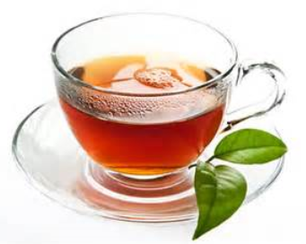
To me, IRT is like …
To me, IRT is like making really expensive tea, because you pay a lot of for the tea leaves and have to wait for a while before the leaves seep long enough in the water for it to taste good. Once the tea is made, you decide it was probably worth the time and money after all.

Slide 3
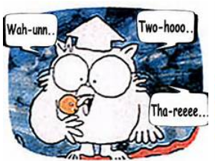
To me, IRT is like …
To me, IRT is like Tootsie pop__, because _you have to get through the hard outer shell of calculus before getting to the soft, chewy inside of IRTPRO____

Slide 4
To me, IRT is like …
To me, IRT is like __swimming_, because it is so hard and so foreign the first few times; you really think you’re drowning. But the more exposure and time you have in IRT the more comfortable and relaxed you get with the material. The same occurs in swimming. The more time you have in the water the easier swimming becomes_.

Slide 5
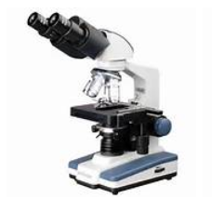
To me, IRT is like …
To me, IRT is like a microscope, because it allows you to see important details that are not initially obvious, but it requires some time and practice to use accurately.
To me, IRT is like ___a microscope__, because _____it allows you to see more information about a question than how it appears on the surface________.

Slide 6
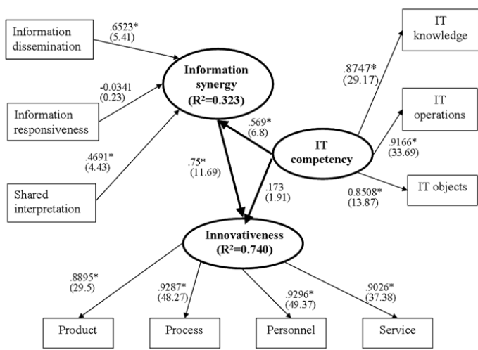
To me, IRT is like …
To me, IRT is like the results from tons of mathematical calculation and another way of explaining SEM because we got parameters from calculating using formula or running SEM models.

Slide 7
To me, IRT is like …
To me, IRT is like music, because it discusses complex realities in seemingly simple tones.

Slide 8
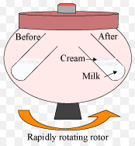
To me, IRT is like …
To me, IRT is like centrifugation in chemistry because it is a process that spins substances rapidly in order to separate that which is otherwise inseparable and unidentifiable. Both IRT and centrifugation take a product and isolate its parts into usable information. Centrifugation spins rapidly and the force of the spinning is what is used to separate the parts. IRT takes large quantities of data and spins it rapidly (IRTPRO or excel equations) to identify the ability of an individual (in chemistry – the substance) and discriminates the level (in chemistry – the identity) of characteristic.

Slide 9
To me, IRT is like …
To me, IRT is like ­trying to find the batteries for your flashlight during a blackout_, because you have no idea where you are or what’s going on, but all of a sudden you find the batteries and everything makes sense.

Slide 10
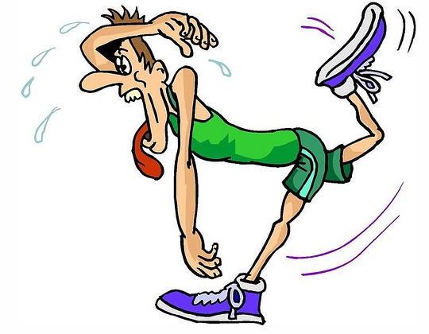
To me, IRT is like …
To me, IRT is like running a 5K for the first time, because it’s both physically and mentally difficult to get through; but once you have one race under your belt, it becomes much easier to run a second or third race.

Slide 11
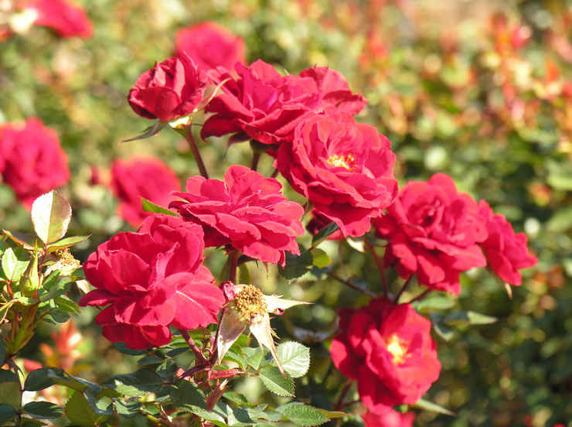
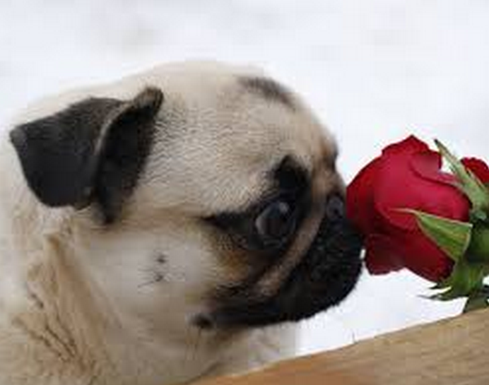
To me, IRT is like …
To me, learning IRT is like learning to plant a rose plant because it started out to be a bit intimidating. As I learn how to cultivate it and how to prune its thorny branches, it becomes more rewarding, especially when I step back to enjoy its beauty and fragrance!

